Slide 1
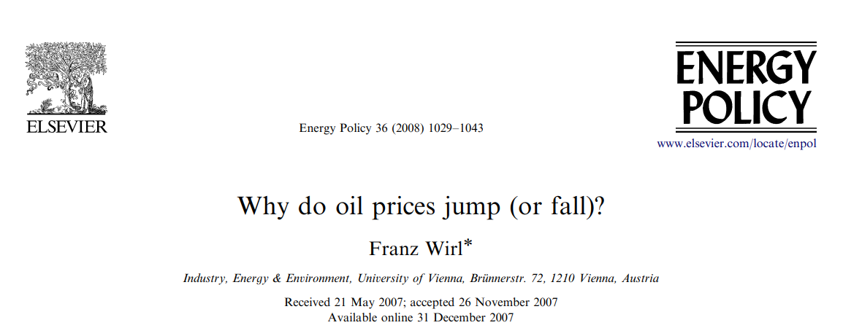

Slide 2
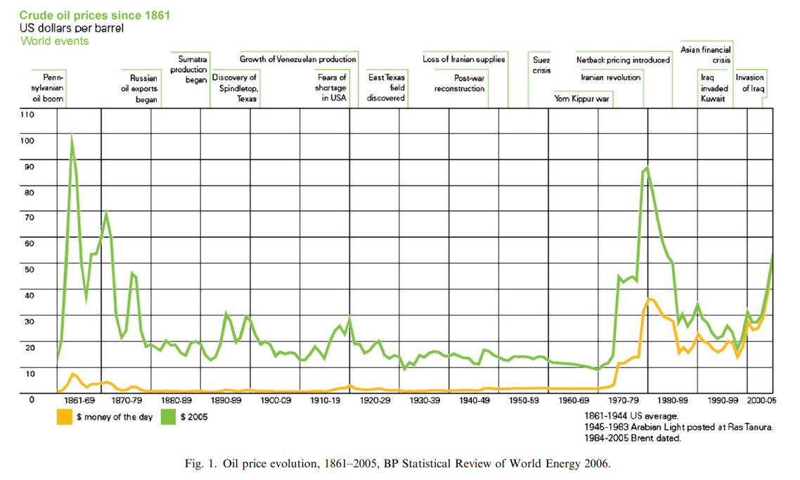

Slide 3
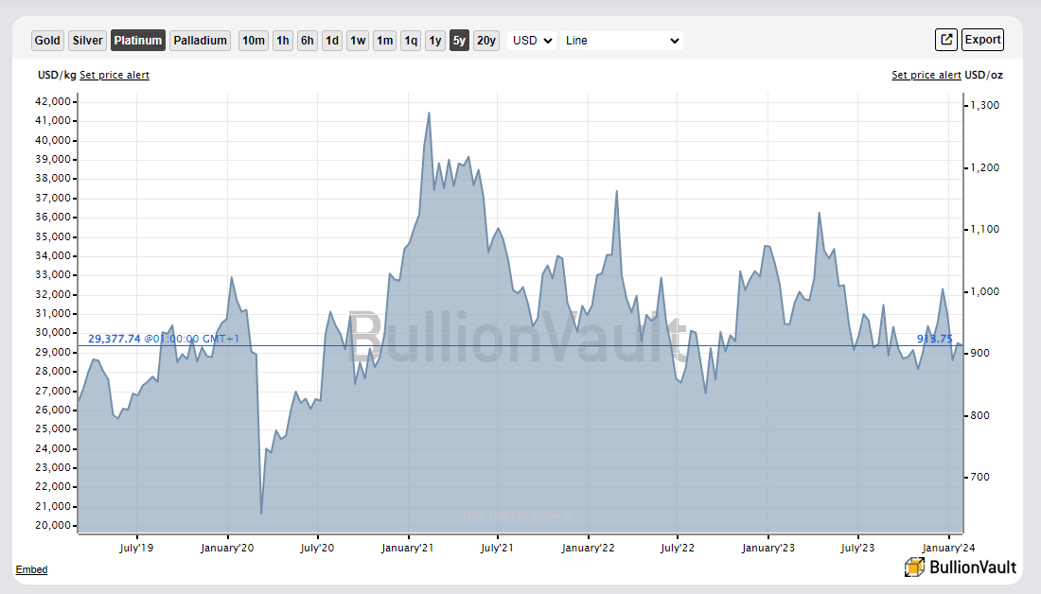

Slide 4




Modeling the supply of strategic raw materials for Europe’s 2030 hydrogen target: analyzing dynamics, risks, and resilience
Marzia Sesini¹, Sebastian Zwickl-Bernhard², Max Münchmeyer², Benjamin F. Hobbs⁴
¹Robert Schuman Centre for Advanced Studies, European University Institute, Via dei Roccettini 9, I-50014 San Domenico di Fiesole, Italy
²Energy Economics Group (EEG), Technische Universität Wien, Gusshausstrasse 25-29/E370-3, 1040 Wien, Austria
³Industrial Economics and Technology Management, Norwegian University of Science and Technology, Gløshaugen, Alfred Getz vei 3, Trondheim, 7491, Norway
⁴Department of Environmental Health & Engineering, The Johns Hopkins University, Ames Hall 313,3400 North Charles Street, Baltimore, MD 21218, USA
EEG seminar / February 01, 2024 / present
Contact: zwickl@eeg.tuwien.ac.at

Slide 5



Before the analytics: how did this group come about?
There was this YEEES event in Vienna back in May 2023.
Antonia and I were looking for senior reviewers, so Hans asked Jean-Michel Glachant to come.
Marzia was sent from “European University Institute” (EUI) and came to our event in person.
Max is a PhD student at the EUI, and Ben was on sabbatical. They all met in Florence, Italy.
Marzia, senior researcher
Ben, professor
Max, PhD student in law

Slide 6
The EU’s critical raw material act (released in March 2023)
The EU is aiming to ensure a secure and sustainable supply of critical raw materials for Europe’s industry.
Critical raw materials (CRMs) are needed for the green and digital transitions
are at the beginning of many industrial supply chains
their global demand is increasing (key components of wind turbines, batteries, etc.)
To enhance long-term competitiveness
To maintain our open strategic autonomy in a fast-changing and increasingly challenging geopolitical environment
EU demand for lithium batteries powering electric vehicles set to increase 12 times by 2030
EU demand for rare earth metals set to rise 5 to 6 by 2030
CRM: 1 of 2
Source: European Critical Raw Material Act

Slide 7

The EU’s critical raw material act
Europe faces dependencies on key critical raw materials.
at least 10%
at least 40%
at least 15%
not more than 65%
63% of the world’s cobalt is extracted om the Democratic Republic of Congo, while 60% is refined in China.
97% of EU’s magnesium supply is sourced from China.
100% of the rare earths used for permanent magnets globally are refined in China.
South Africa provides 71% of the EU’s needs for platinum group metals.
CRM: 2 of 2
Source: European Critical Raw Material Act

Slide 8
EU’s hydrogen target by 2030 and our core objective
2022’s “REPower EU” plan highlights investments in renewable energy, with a 10 bcm H2 production target by 2030.
Leading to a projected sharp increase in electrolyze and fuel cell capacity
increase in demand for platinum by 24%, iridium 43%, and scandium 68% by 2030 (IEA, 2022)
Focusing on the need for critical raw materials in the hydrogen economy uptake, our paper examines:
The interaction between the dominant player in the market for platinum and the EU.
In light of global demand for CRMs, the work assesses whether the CRM Act contributes to the resilience of Europe’s CRM supply chain, particularly in addressing the potential risks associated with its ambitious hydrogen domestic production targets by 2030.
It investigates the impact of the market-dominant player's strategic behavior, encompassing factors such as supply disruptions, on the European supply chain for platinum, crucial for hydrogen production.

Slide 9
Research questions
How does the main player's strategic dominance in the platinum market influence the EU's supply chain dynamics, particularly in terms of supply chain dependency, vulnerability to disruptions, and the impact on technological innovation, and what are the long-term implications for the European CRM sector?
To what extent does the CRM Act, through provisions compliance and effectiveness in promoting diversification, contribute to reducing the EU's dependency on the dominant player REEs, creating a more resilient CRM supply chain, and fostering technological innovation in the platinum sector?
How do the stockpiling provisions of the CRM Act mitigate the impact of geopolitical tensions and supply disruptions on the EU's REEs supply chain, and to what extent do these provisions contribute to the resilience of the supply chain, address challenges in meeting hydrogen production targets, and influence strategic decision-making amid market uncertainties and volatility?

Slide 10
Literature review
As far as the proposed techno-economic modeling approach is concerned, to the best of our knowledge there is no equivalent publication. Still, the literature offers studies that are worth mentioning.
A focus of existing studies is certainly the modeling of the CRM demand and requirements in techno-economic, mostly large-scale energy system models (e.g., Liang (2022), Zhang (2023), Tokimatsu (2017), and Peiró (2022)).
Another strand of the existing literature deals with the prices of CRMs and how they might evolve in the context of an expected significant increase during the sustainable transition of the global energy system. (e.g., Sun (2011), Schnuelle (2019), Parra and Patel (2016), Robinson (2017), Bao (2020))
Another interesting aspect is the secondary supply and the recycling of CRMs.
The current literature already provides plenty of studies dealing, for example, with the recycling of steel and iron from a techno-economic perspective but hardly any about CRMs especially platinum. (one exception: Tong (2022))

Slide 11
Proposed bi-level optimization model (overview)
A deterministic bi-level optimization problem is proposed to answer the research questions.
The lower-level problem considers the behavior of competitive fringe supply, in which a fixed demand is met by minimizing supply cost by the fringe suppliers, given the upper-level decisions by the major exporter (“Stackelberg” leader).
The leader maximizes her profit and can exercise market power.
The main links between the lower-level problem and the upper-level problem are the export price and quantity offered by the major exporter to the market clearing¹ and, in the other direction, the cleared quantity and price².
In the lower-level problem, the market clearing is treated separately for the European and global markets M1 and M2 (by having two separate supply-demand equilibrium constraints), but the total cost of both is minimized.
¹Decision variables from the upper-level problem serve as parameters for the lower-level problem.
²Decision variables from the lower-level, whose dependence on the upper-level variables is recognized by the leader

Slide 12
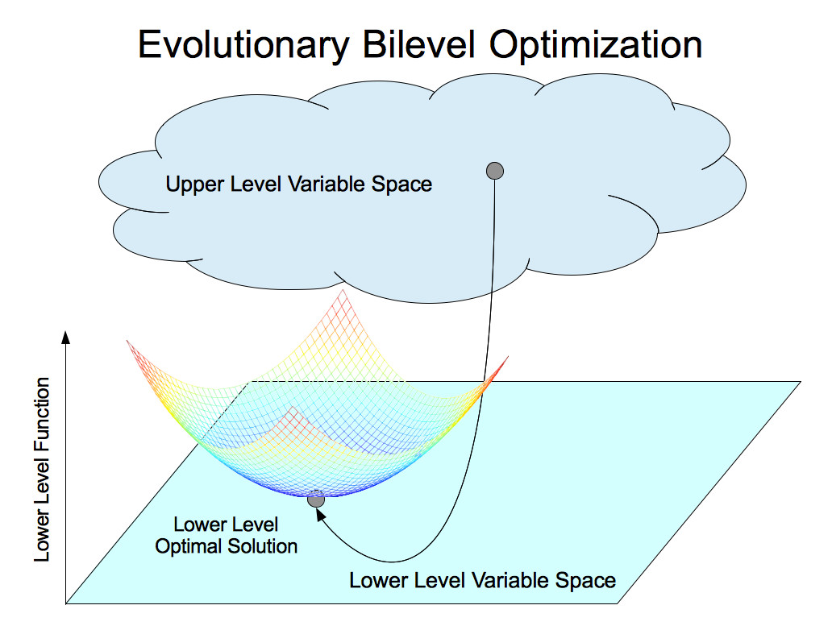
The basics of bi-level optimization (1 / 2)
An upper-level feasible solution must be an optimal lower-level solution.
Sequential game: the upper-level (leader) acts first, then the lower-level (follower).
Therefore, full information about the lower-level problem (objective, constraints, etc.) of the upper-level problem is assumed.
In other words, equilibrium means that neither the leader nor the follower can improve its objective (function value) by a change in strategy.
Figure: Evolutionary bilevel optimization

Slide 13
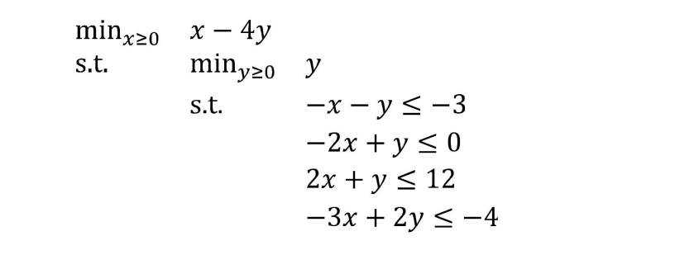
The basics of bi-level optimization (2 / 2)
A simple example.
Source: Modeling Bilevel Programs in Pyomo

Slide 14
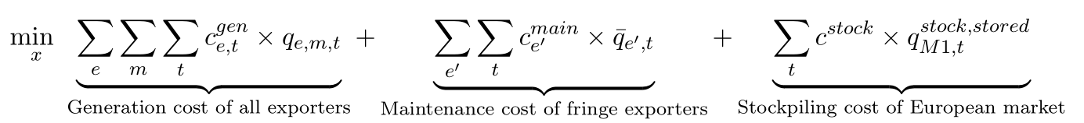
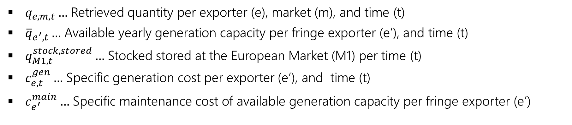
Lower-level problem (market clearing at minimized total cost)
The objective is to minimize the sum of the generation cost of all exporters, the maintenance cost of fringe exporters, and the stockpiling cost of the European market when satisfying the demand of the European and global markets.
$q_{e,m,t}…$ Retrieved quantity per exporter (e), market (m), and time (t)
${\overline{q}}_{e^{′},t}…$ Available yearly generation capacity per fringe exporter (e’), and time (t)
$q_{M1,t}^{stock,stored}…$ Stocked stored at the European Market (M1) per time (t)
$c_{e,t}^{gen}…$ Specific generation cost per exporter (e’), and time (t)
$c_{e^{′}}^{main}…$ Specific maintenance cost of available generation capacity per fringe exporter (e’)

Slide 15
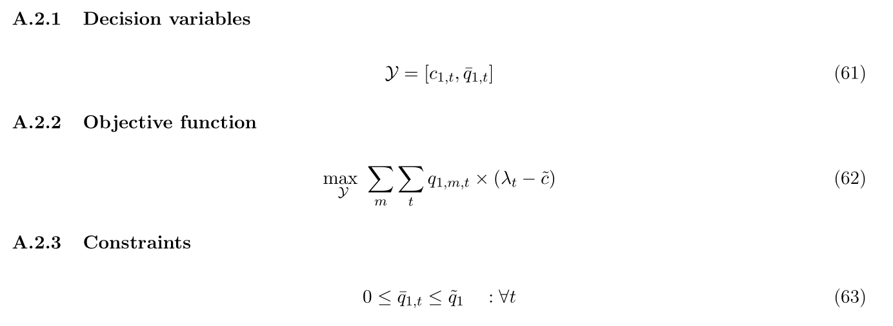
Upper-level problem (profit maximization of the major exporter)
As is often the case with bi-level optimization, the upper-level problem is much simpler than the lower-level problem. There are only two equations: the objective function (top) and a capacity constraint.

Slide 16
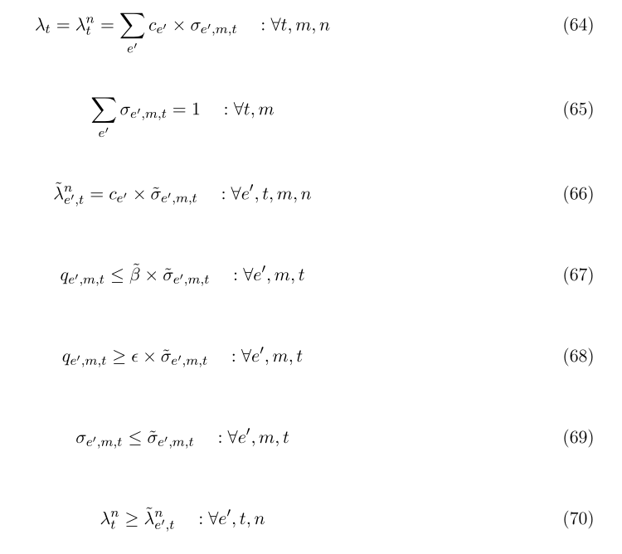
Steps to make the model solvable (1/3)
Linear reformulation of the quadratic term $q_{1,m,t}∗λ_{t}$: $σ_{e^{′},m,t}$ (binary), ${\tilde{λ}}_{e^{′},t}^{n}$ (continuous), ${\tilde{σ}}_{e^{′},m,t}$ (binary); $\tilde{β}$ and ε (parameters)
➔ Equation (64) means that the market clearing price (dual variable of the demand balance constraint) is equal to the marginal production cost of the marginal supplier.

Slide 17
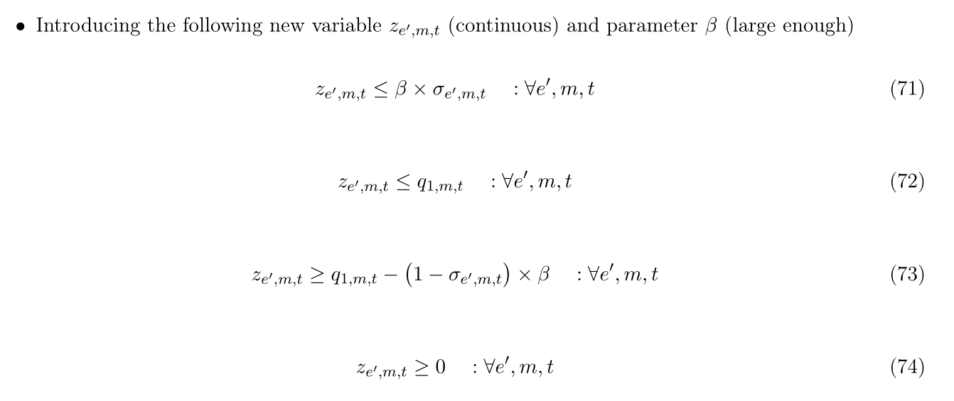
Steps to make the model solvable (2/3)

Slide 18
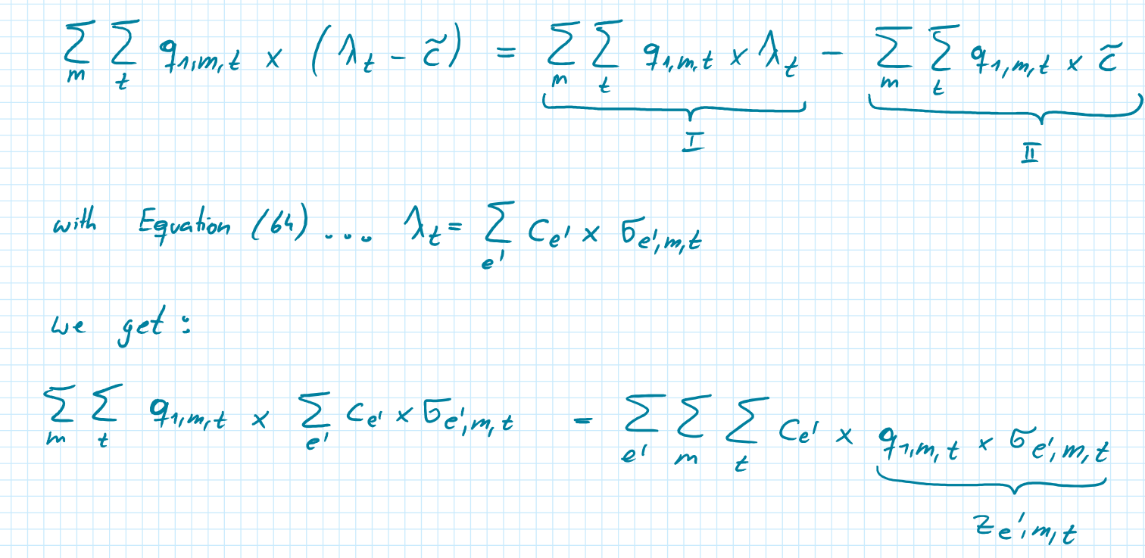
Steps to make the model solvable (3/3)

Slide 19
Key takeaways and next steps
Not much literature exists dealing with the techno-economic modeling of critical raw material supply for the decarbonization of energy systems (this is especially true for platinum)
Advanced modeling techniques are likely to be required for the modeling, as traditional cost-minimizing approaches do not adequately represent the expected market situation.
In case bi-level optimization is applied: invest sufficient time to really understand your lower-level problem in detail
Trade-off between keep the lower-level problem as simple as possible and having the “right” number of constraints (be aware of KKTs)
Non-linear terms (such as Price times quantity) can be linearized in some cases
In particular when a reformulation by a product of a continuous and binary decision variable
Hopefully, I will have results by the end of February (we want to submit the paper to “Energy Economics” by the end of march)
What had to be proved: The EEG seminar is a place where you can present ongoing / not finished work!

